Slide 1
Intermediate Macroeconomics Axelle FERRIERE, Sciences Po, Spring 2025
Ch. 4
The Solow growth model

Slide 2
Goal of this chapter
Previous chapter: a model of production
Studied whether differences in capital per capita explain differences in output per capita.
But did not investigate why countries differ in the level of capital per capita.
Solow growth model – a model of capital accumulation
Q: What generates cross-country differences in the level of capital per capita? Why do economies grow?
Tools
Capital accumulation equation
Transition dynamics and steady state

Slide 3
Outline
Empirical evidence
Setting up the Solow growth model
Saving, investment, and the real interest rate
Solving the Solow growth model
Transition dynamics
Steady state analysis, comparative statics
Predictions of the model and empirical evidence
Lessons and deficiencies

Slide 4
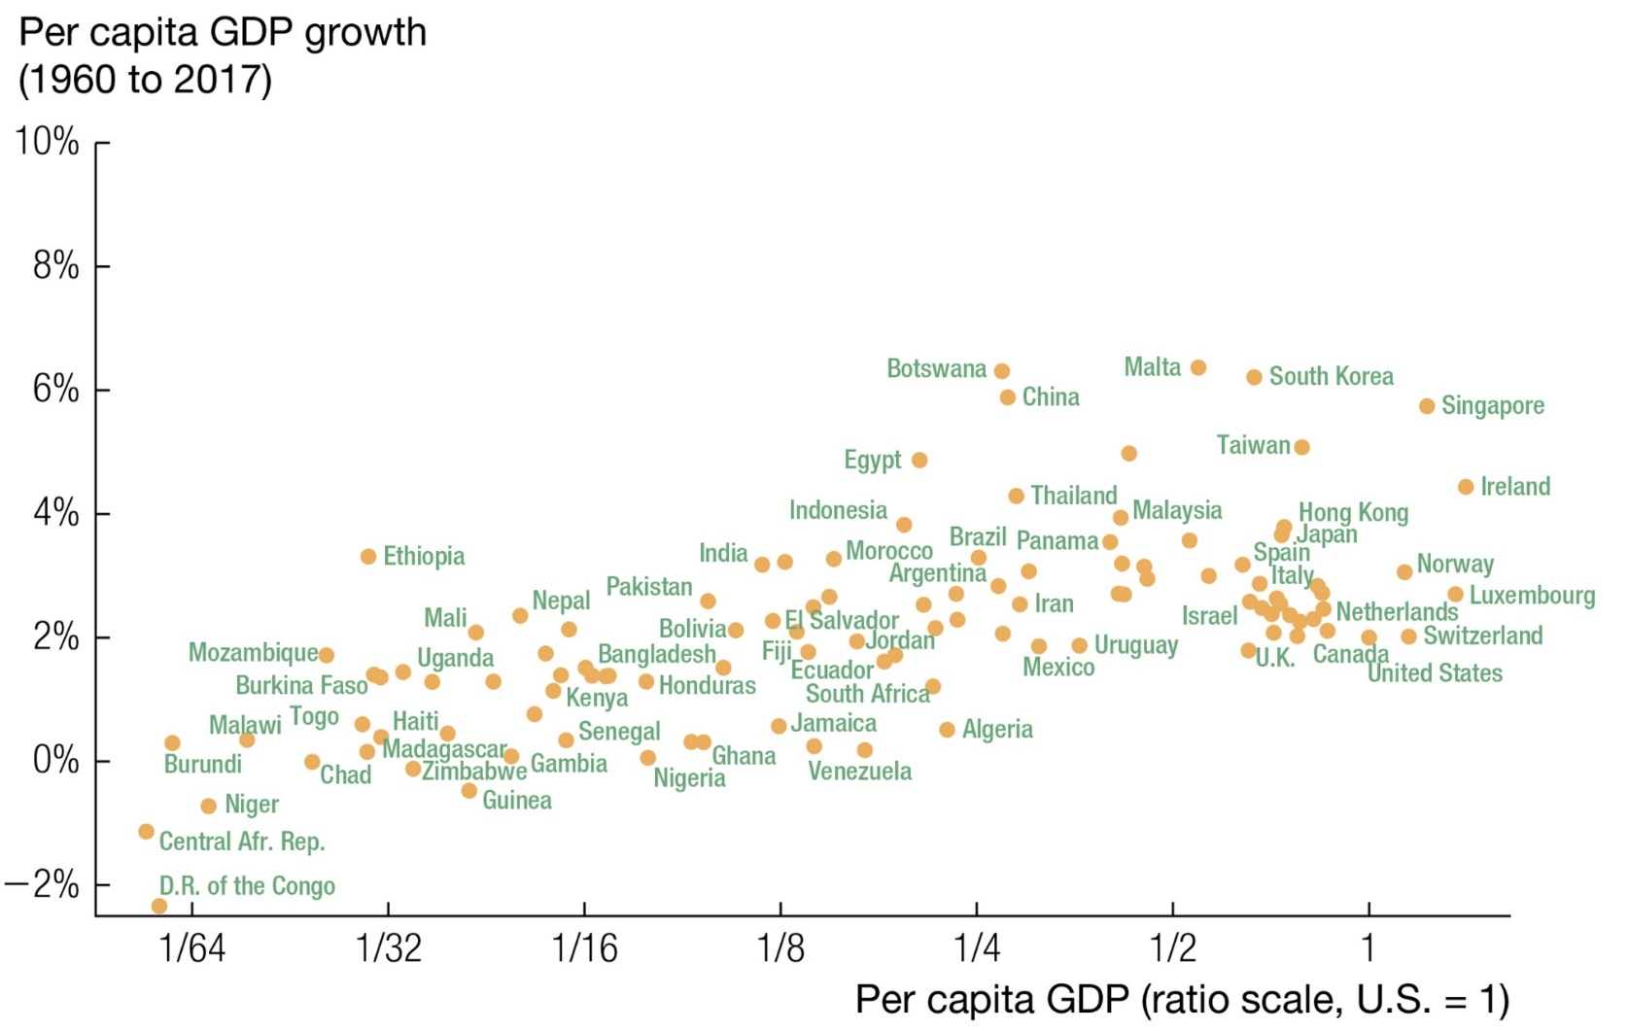
A cross-country comparison – ex post
Countries have different growth rates and different levels of GDP per capita. But why?
Countries that grow end up richer.
in 2017
Source: Jones – Macroeconomics

Slide 5
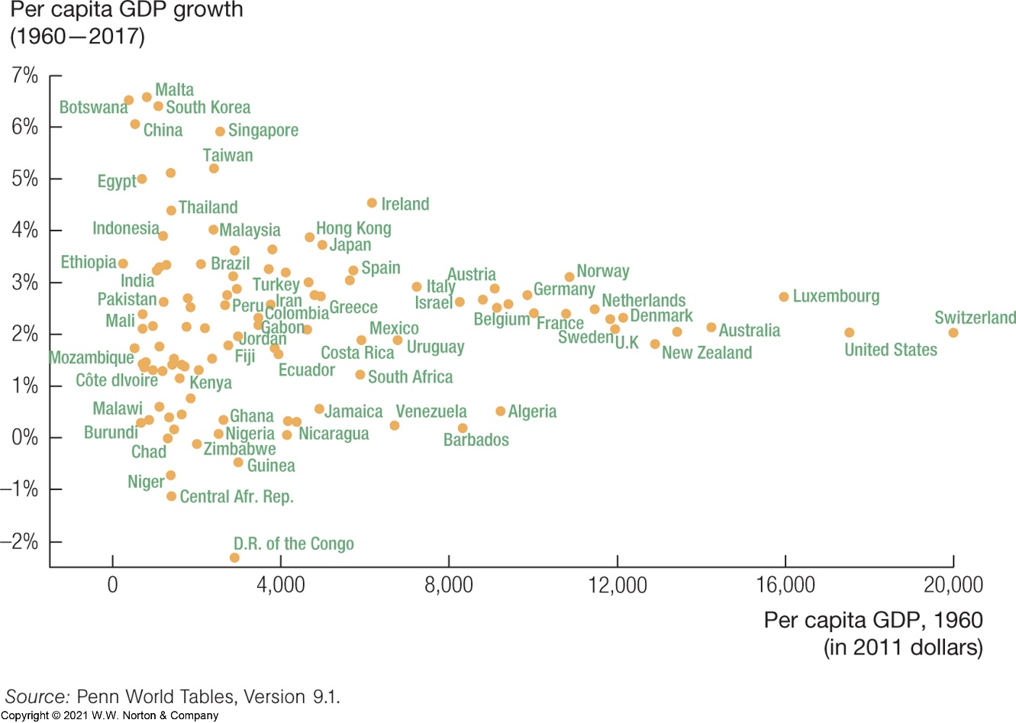
A cross-country comparison – ex ante
What about the role of initial conditions? Do countries that start poor catch up? Is there convergence?
Countries that started rich in 1960 grew at stable rates around 2%.
Growth rates of countries that started poor were all over the place.
Growth miracles and growth disasters.
No convergence ?
growth miracles
growth disasters
Source: Jones – Macroeconomics

Slide 6
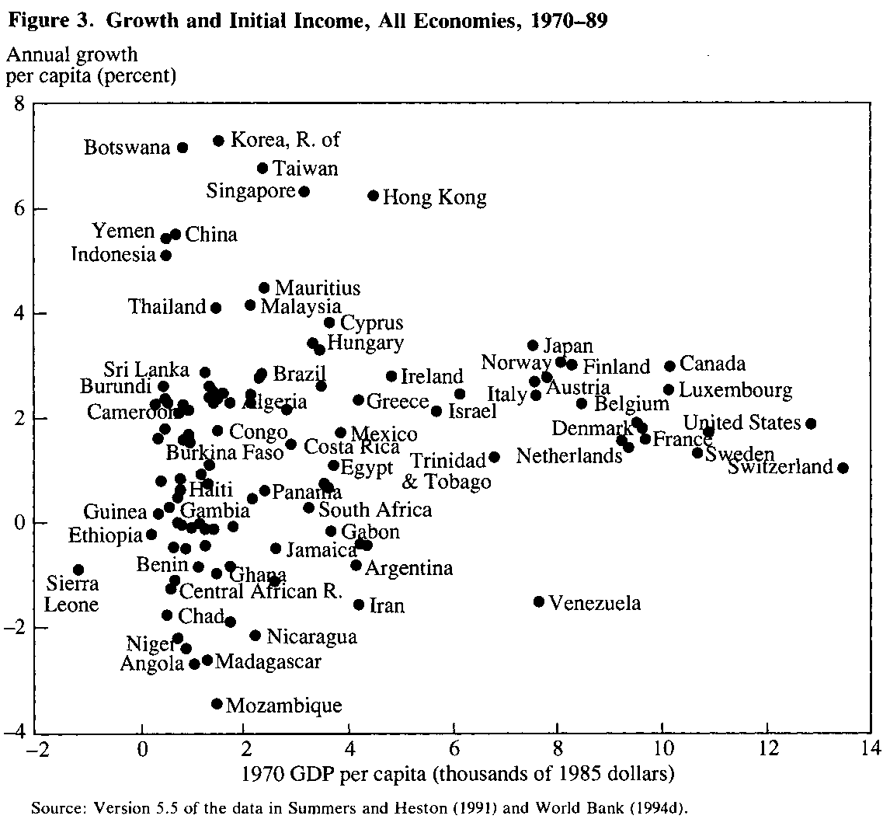
A cross-country comparison – ex ante
What about the role of initial conditions? Do countries that start poor catch up? Is there convergence?
growth miracles
Countries that started rich in 1970 grew at stable rates around 2%.
Growth rates of countries that started poor were all over the place.
Growth miracles and growth disasters.
No convergence ?
growth disasters
Source: Sachs, Warner (1995) Economic Reform and the Process of Globalization

Slide 7
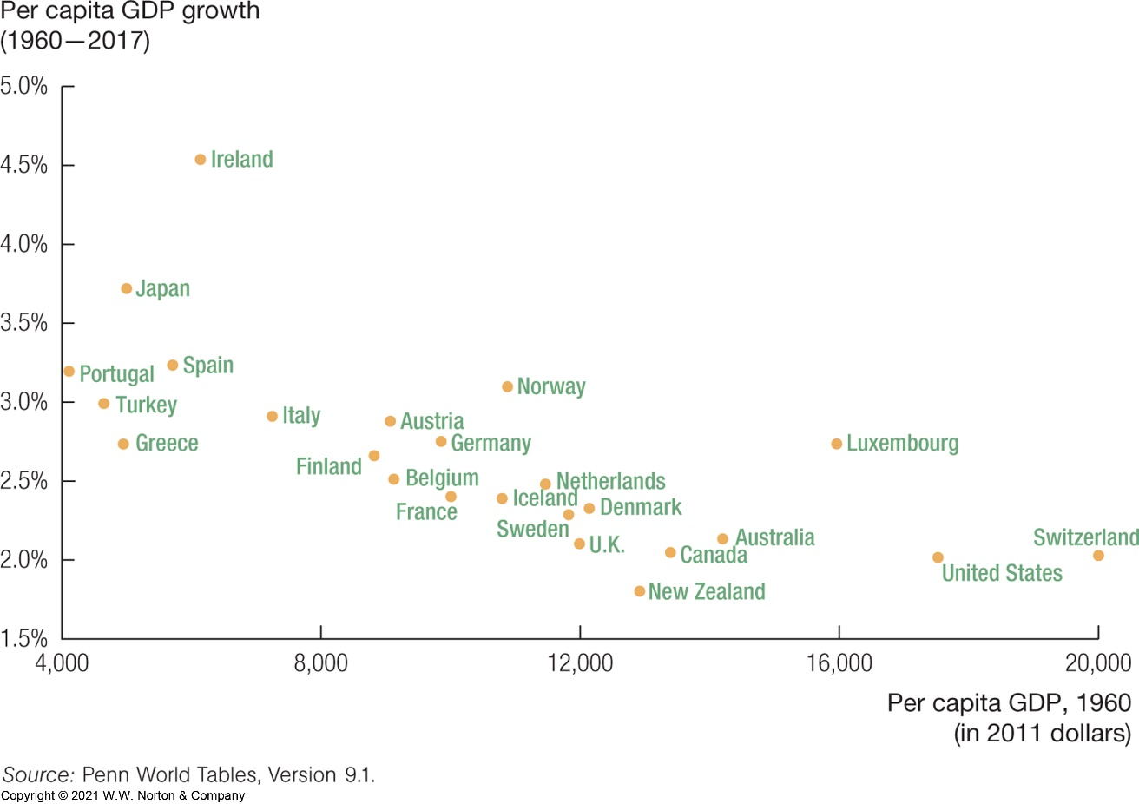
A cross-country comparison – ex ante
Let us look only at countries that opened their economies (probably also conducted other sensible policies).
OECD economies
Poor countries grow much faster.
Convergence!
We will see such dynamics in our model. Countries grow fast initially, then growth slows down.
Source: Sachs, Warner (1995) Economic Reform and the Process of Globalization

Slide 8
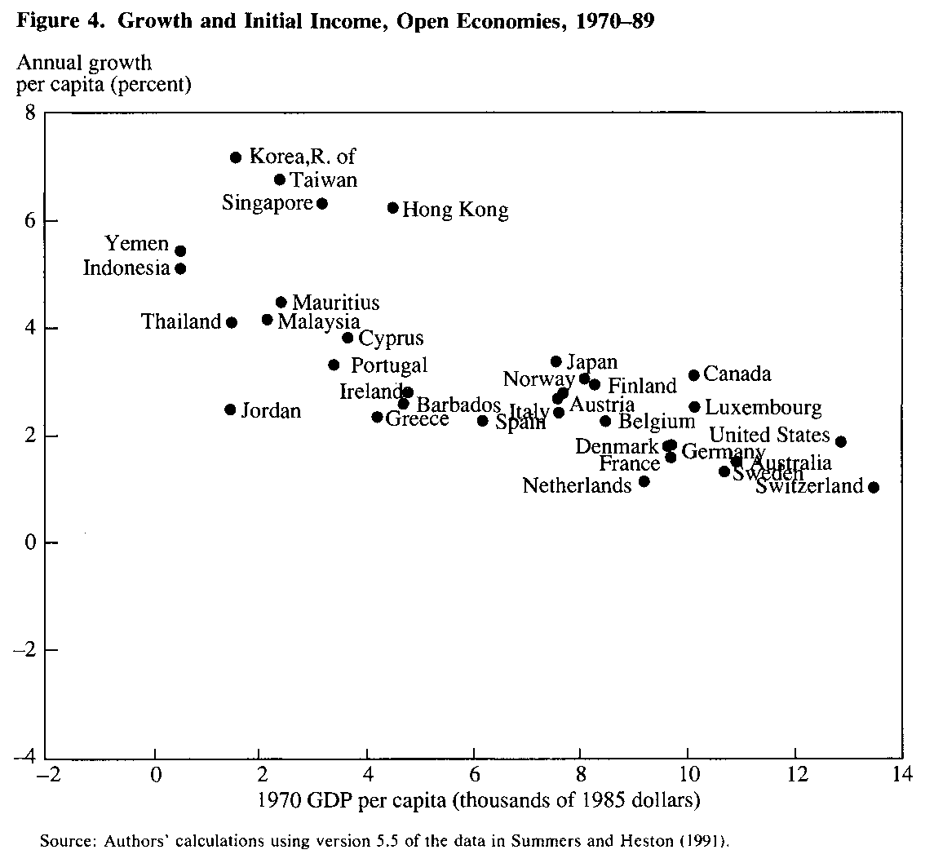
A cross-country comparison – ex ante
Let us look only at countries that opened their economies (probably also conducted other sensible policies).
Poor countries grow much faster.
Convergence!
We will see such dynamics in our model. Countries grow fast initially, then growth slows down.
Source: Sachs, Warner (1995) Economic Reform and the Process of Globalization

Slide 9
Example: South Korea and the Philippines
1960: very similar countries
Per capita GDP around $1500
Population: around 25 million, ½ working age
Similar sectoral composition (industry, agriculture)
College enrollment: South Korea 5%, Philippines 13%
Sharp divergence between 1960 and 2009
Growth: South Korea = 5.4%, Philippines = 1.6% per annum
Per capita GDP in 2009
South Korea $25,000
Philippines $3,000
What happened?

Slide 10
Solow growth model
Robert Solow 1956 (Nobel Prize 1987)
Idea: Capital accumulation as source of growth
Moodle: paper from 1956, “A Contribution to the Theory of Economic Growth”
Nobel Speech and Press Release from 1987
This chapter: explain differences in capital per capita through saving and investment that leads to capital accumulation.

Slide 11
Economic dynamics
We are moving from a static to a dynamic model
At different points in time the economy will evolves differently
Dynamic structure of the model
Country starts with a given amount of capital = initial condition.
It accumulates it over time = moves along a transition path…
… and converges to a constant level of capital in the long run = steady state.
Are two economies different because they started at different initial conditions? Or because they have different parameters and are going to different steady states?

Slide 12
Economic dynamics
Steady state and dynamics to steady state will depend on the saving rate = fraction of income not consumed but saved and used as investment
Intertemporal decision-making
Decisions today affect the economy in the future
E.g., saving decision this period affects how much can be produced in the next period.
Very important in macroeconomics!

Slide 13
Outline
Empirical evidence
Setting up the Solow growth model
Saving, investment, and the real interest rate
Solving the Solow growth model
Transition dynamics
Steady state analysis, comparative statics
Predictions of the model and empirical evidence
Lessons and deficiencies

Slide 14
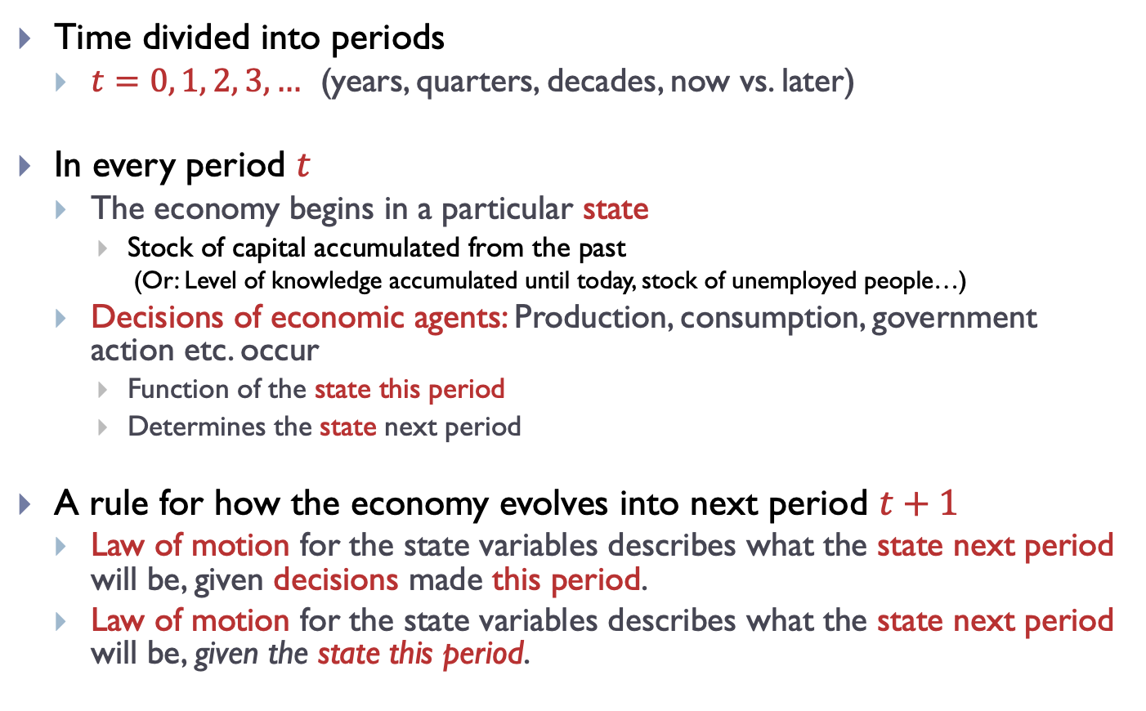
The role of dynamics
Time divided into periods
$t=0, 1, 2, 3,…$ (years, quarters, decades, now vs. later)
In every period $t$
The economy begins in a particular state
Stock of capital accumulated from the past
(Or: Level of knowledge accumulated until today, stock of unemployed people…)
Decisions of economic agents: Production, consumption, government action etc. occur
Function of the state this period
Determines the state next period
A rule for how the economy evolves into next period $t+1$
Law of motion for the state variables describes what the state next period will be, given decisions made this period.
Law of motion for the state variables describes what the state next period will be, given the state this period.

Slide 15
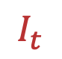
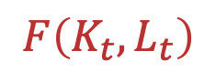
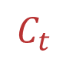
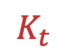
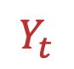
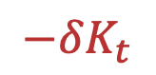

Framework of the model – sketch
$$K_{t}$$
$$L_{t}$$
capital
labor
new capital
for next
period
$$F\left(K_{t},L_{t}\right)$$
production technology
depreciation
$$−δK_{t}$$
output
$$Y_{t}$$
investment
consumption
$$I_{t}$$
$$C_{t}$$

Slide 16
Stock and flow variables
There are two types of variables in the model.
Stock variables
A quantity that is measured at an instant in time.
Stock of capital (buildings, …), population, …
Flow variables
A quantity that is measured over a period of time.
Output – produced over the course of a year.
Investment, depreciation, …
Flow of investment adds to the stock of capital.
Distinguish
Savings on a bank account (stock) vs interests (flow)
Capital (stock) vs capital services provided (flow)

Slide 17
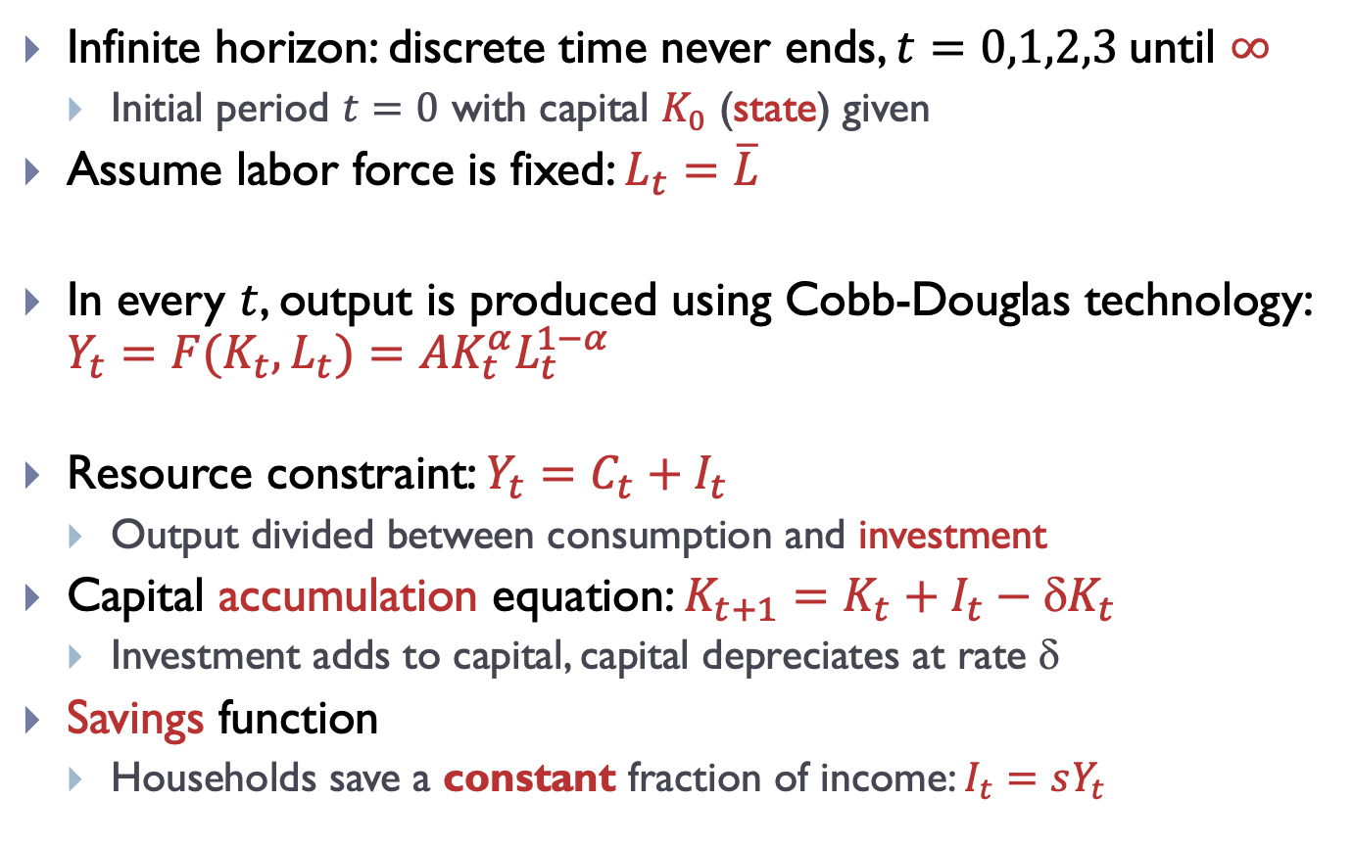
Framework of the model
Infinite horizon: discrete time never ends, $t=0,1,2,3$until $∞$
Initial period $t=0$ with capital $K_{0}$ (state) given
Assume labor force is fixed: $L_{t}=\overline{L}$
In every $t$, output is produced using Cobb-Douglas technology: $Y_{t}=F(K_{t},L_{t})=AK_{t}^{α}L_{t}^{1−α}$
Resource constraint: $Y_{t}=C_{t}+I_{t}$
Output divided between consumption and investment
Capital accumulation equation: $K_{t+1}=K_{t}+I_{t}−{K}_{t}$
Investment adds to capital, capital depreciates at rate $$
Savings function
Households save a constant fraction of income: $I_{t}=sY_{t}$

Slide 18
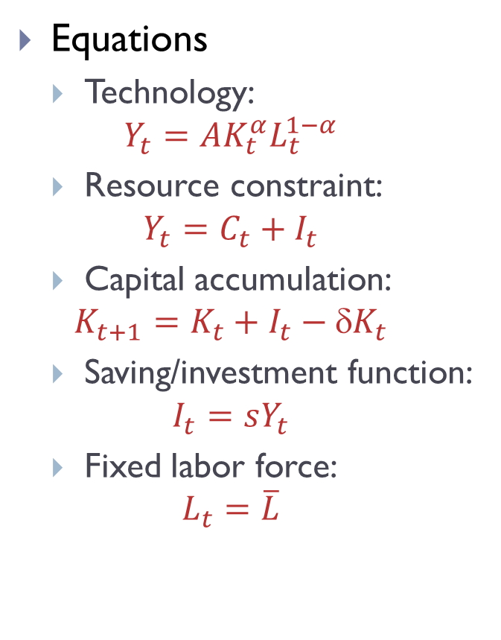
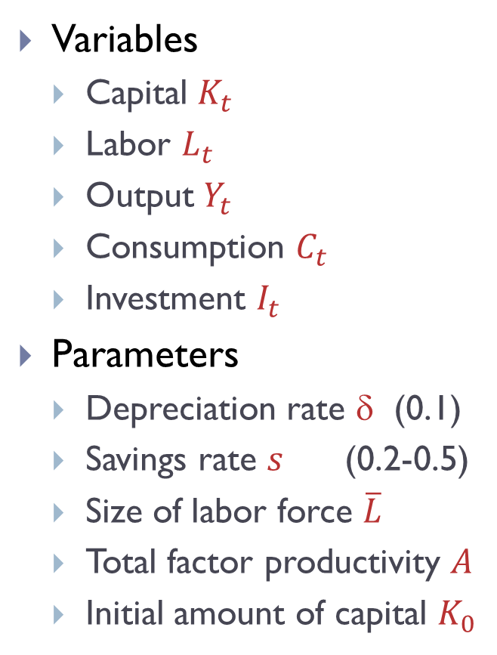
Framework of the model
Variables
Capital $K_{t}$
Labor $L_{t}$
Output $Y_{t}$
Consumption $C_{t}$
Investment $I_{t}$
Parameters
Depreciation rate $$ (0.1)
Savings rate $s$ (0.2-0.5)
Size of labor force $\overline{L}$
Total factor productivity $A$
Initial amount of capital $K_{0}$
Equations
Technology:
$$Y_{t}=AK_{t}^{α}L_{t}^{1−α}$$
Resource constraint:
$$Y_{t}=C_{t}+I_{t}$$
Capital accumulation:
$$K_{t+1}=K_{t}+I_{t}−{K}_{t}$$
Saving/investment function:
$$I_{t}=sY_{t}$$
Fixed labor force:
$$L_{t}=\overline{L}$$
5 equations, 5 variables

Slide 19
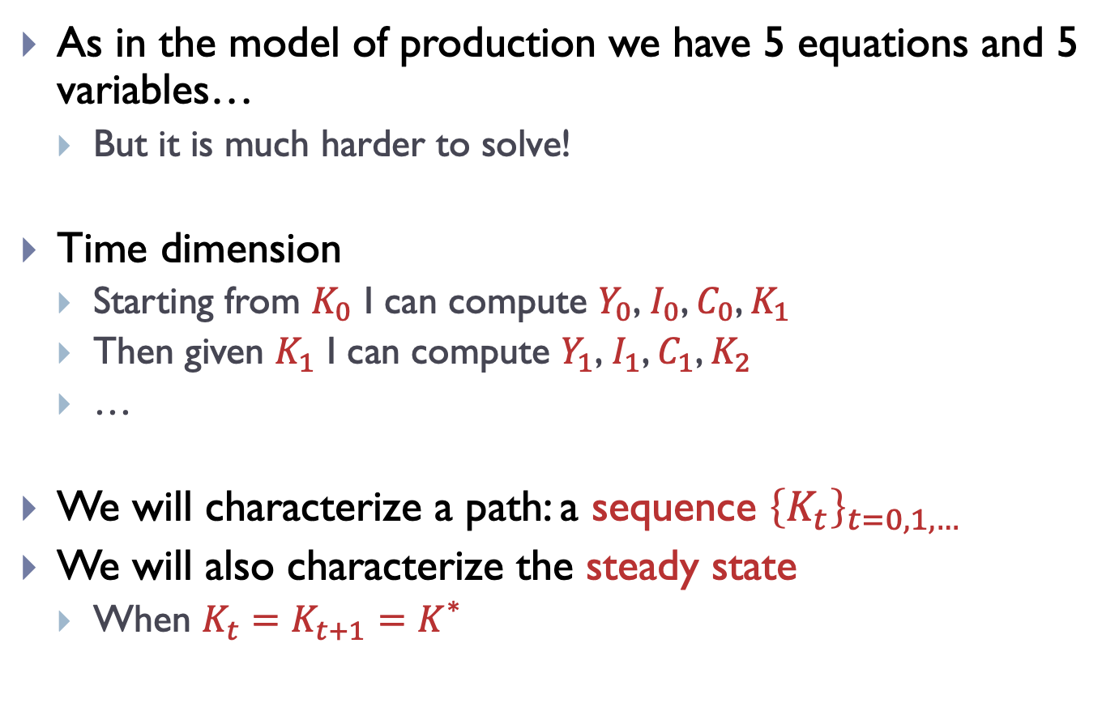
Framework of the model
As in the model of production we have 5 equations and 5 variables…
But it is much harder to solve!
Time dimension
Starting from $K_{0}$ I can compute $Y_{0}\text{,} I_{0}$, $C_{0}$, $K_{1}$
Then given $K_{1}$ I can compute $Y_{1}\text{,} I_{1}$, $C_{1}$, $K_{2}$
…
We will characterize a path: a sequence ${\left\{K_{t}\right\}}_{t=0,1,… }$
We will also characterize the steady state
When $K_{t}=K_{t+1}=K_{}^{∗}$

Slide 20
Outline
Empirical evidence
Setting up the Solow growth model
Saving, investment, and the real interest rate
Solving the Solow growth model
Transition dynamics
Steady state analysis, comparative statics
Predictions of the model and empirical evidence
Lessons and deficiencies

Slide 21
How to think about saving and investment
Example: a farm
A farm starts in winter with seed grains (capital).
In spring, the crop is planted (used in production).
Some of the grains get lost when being planted (depreciation).
In fall, harvest (output) is collected.
Farmer puts aside the original amount of grains (capital).
A fraction of the remaining harvest is used for consumption.
The rest is stored and increases the amount of capital (investment).

Slide 22
How to think about saving and investment
Observe that there is no money in this economy.
Households do not save using money. They save by accumulating real resources (capital).
Here, they can decide whether to use grains for consumption or as investment (perfectly substitutable goods).
In reality, agents would have to decide beforehand whether to produce investment goods or consumption goods.

Slide 23
Saving and investment decision
How do households decide how much to save?
Here, we assume that households save a constant fraction of income.
In a more complicated model, households would compare the benefits of consuming the good today with the benefits of saving and consuming later (example: farmer and grains).
Consumption smoothing

Slide 24
Saving and investment decision
Observe that an economy can grow faster if it increases its saving rate.
Households have to sacrifice current consumption = tradeoff.
Example: Chinese saving rate is high. Future generations will be better off but current generations would benefit from more consumption today.
How much should the household save?
That depends on the interest rate it receives on the savings.
Here, the household saves real resources = real interest rate.
Return on investment = the return capital owners earn for saving a unit of output and renting it out to firms
Rental price of capital = price firms pay to capital owners
Marginal product of capital = amount an extra unit of capital earns in a firm (paid to capital owners)

Slide 25
Outline
Empirical evidence
Setting up the Solow growth model
Saving, investment, and the real interest rate
Solving the Solow growth model
Transition dynamics
Steady state analysis, comparative statics
Predictions of the model and empirical evidence
Lessons and deficiencies

Slide 26
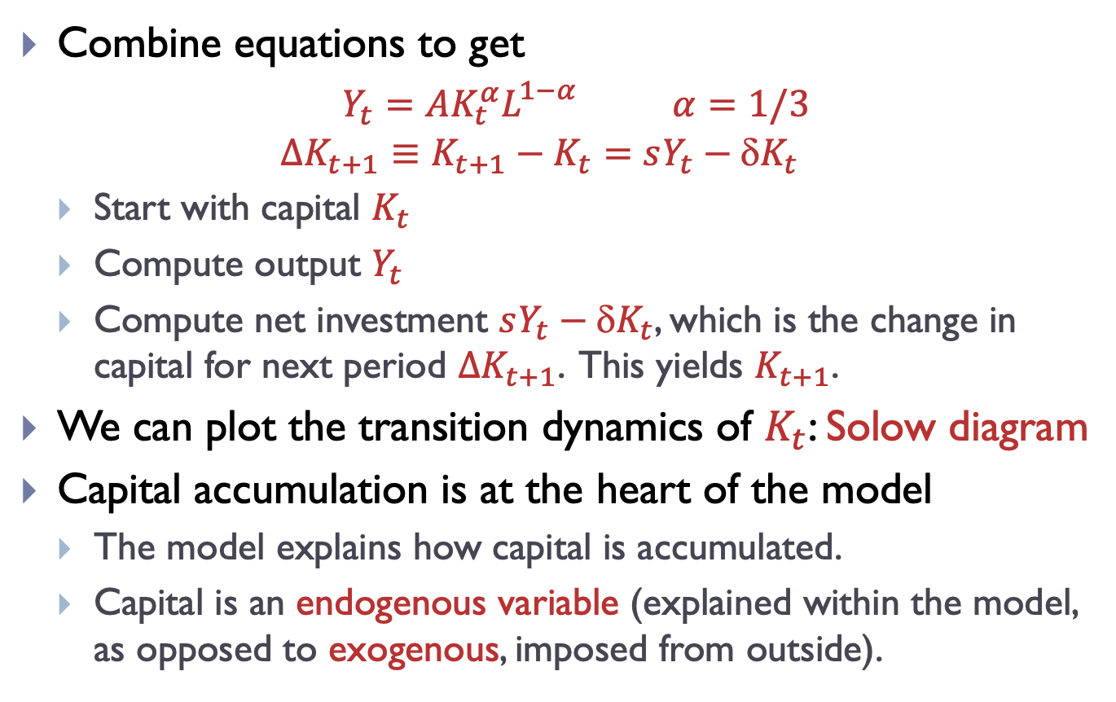
Solving the Solow growth model
Combine equations to get
$Y_{t}=AK_{t}^{α}L_{}^{1−α}$ $α=1/3$
$${∆K_{t+1}≡K}_{t+1}−K_{t}=sY_{t}−{K}_{t}$$
Start with capital $K_{t}$
Compute output $Y_{t}$
Compute net investment $sY_{t}−{K}_{t}$, which is the change in capital for next period $∆K_{t+1}$. This yields $K_{t+1}$.
We can plot the transition dynamics of $K_{t}$: Solow diagram
Capital accumulation is at the heart of the model
The model explains how capital is accumulated.
Capital is an endogenous variable (explained within the model, as opposed to exogenous, imposed from outside).

Slide 27
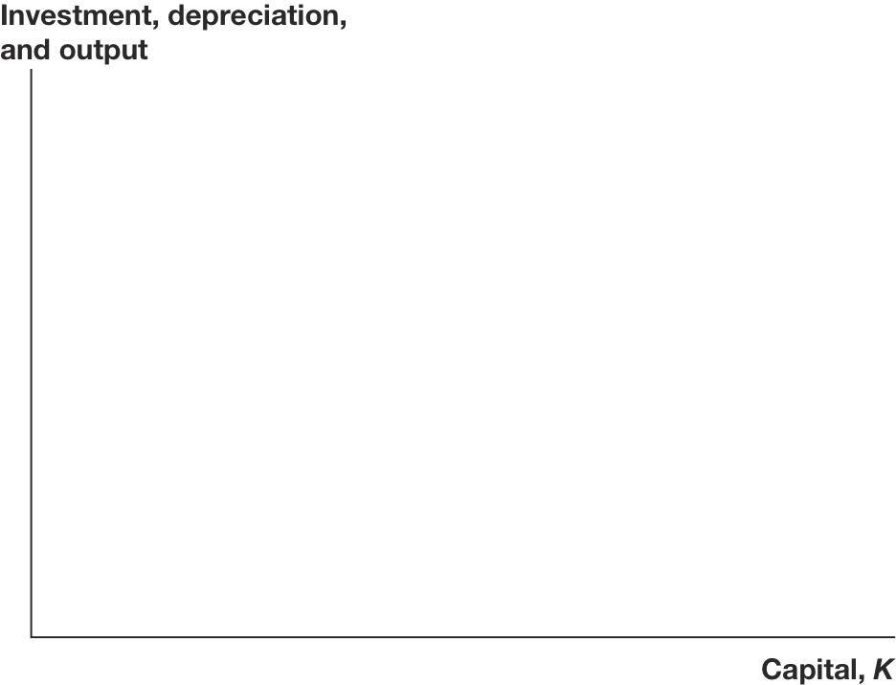
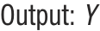



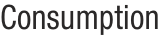
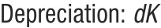
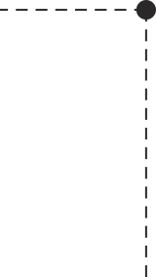
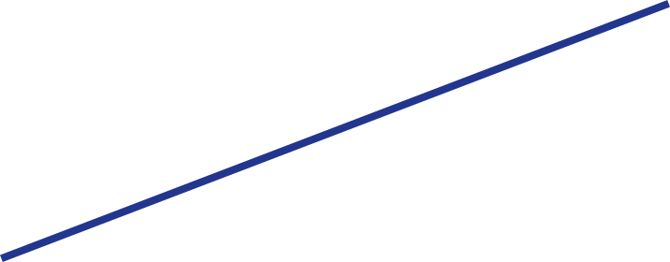

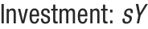
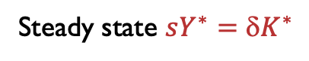
Solow diagram
$∆K_{t+1}=sY_{t}−{K}_{t}$, $Y_{t}=AK_{t}^{α}L_{}^{1−α}$
Steady state $sY^{∗}={K}^{∗}$
Source: Jones – Macroeconomics

Slide 28
Steady states vs. long-run growth
Economy converges to a steady state
Capital accumulation alone cannot generate long-run growth!
Is the steady state every reached?
Only asymptotically.
Why does growth vanish in the long run?
Depreciation is a constant share of capital.
But production exhibits diminishing marginal product of capital (diminishing returns to capital).
As capital increases, it is ever harder to replenish depreciated capital.
This is a disappointing result, caused by diminishing returns to capital.
Solution? Something else has to grow as well.
Some factor included in TFP? Human capital, inventions, …

Slide 29
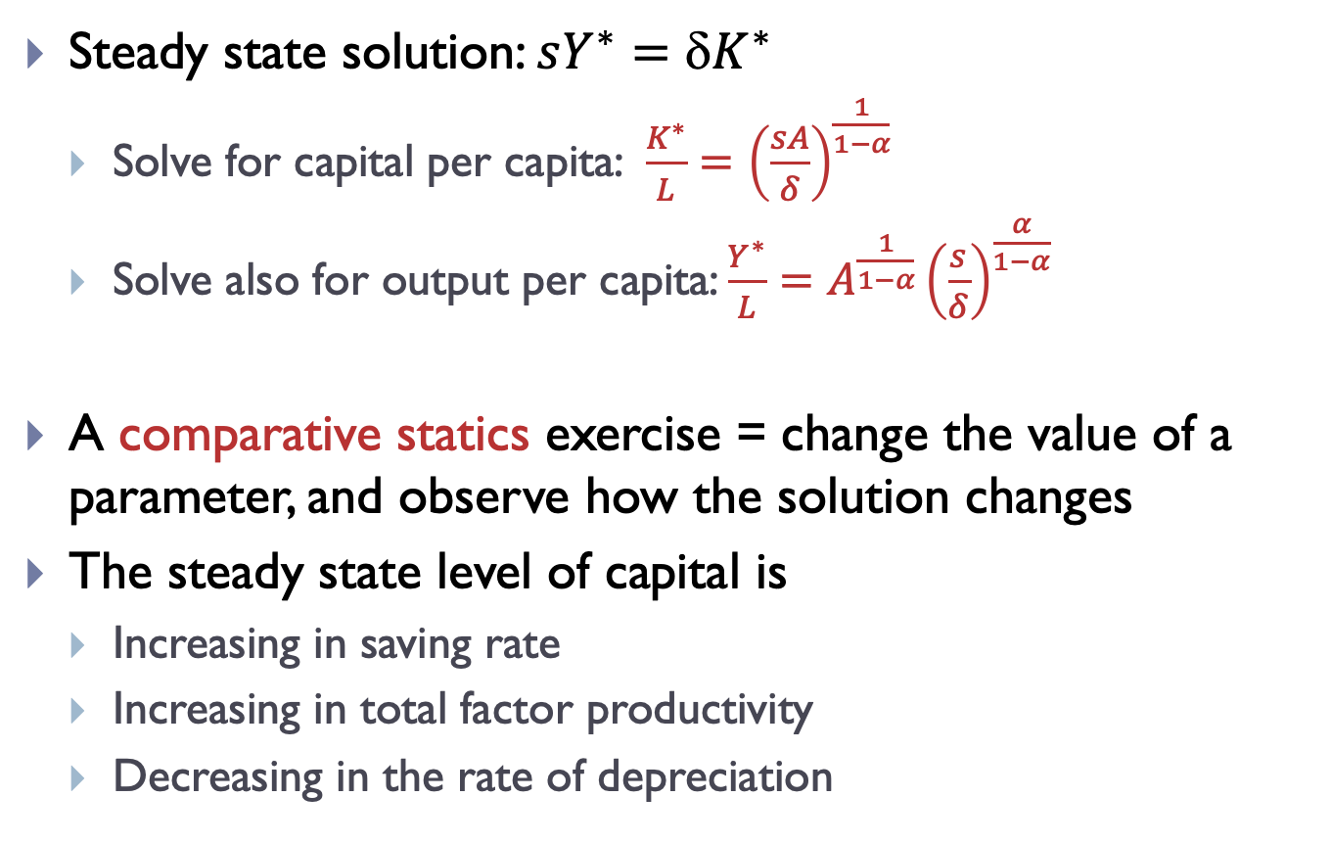
Characterizing the steady state
Steady state solution: $sY^{∗}={K}^{∗}$
Solve for capital per capita: $\frac{K^{∗}}{L}={\left(\frac{sA}{δ}\right)}^{\frac{1}{1−α}}$
Solve also for output per capita: $\frac{Y^{∗}}{L}=A^{\frac{1}{1−α}}{\left(\frac{s}{δ}\right)}^{\frac{α}{1−α}}$
A comparative statics exercise = change the value of a parameter, and observe how the solution changes
The steady state level of capital is
Increasing in saving rate
Increasing in total factor productivity
Decreasing in the rate of depreciation

Slide 30
Transition dynamics
Characterizing transitions
Harder in closed form
Questions we can ask with this model:
Imagine that the economy starts in the steady state, and a natural disaster destroys 20% of the capital stock. What happens then?

Slide 31
Solow diagram – natural disaster
Source: Jones – Macroeconomics

Slide 32
Transition dynamics
Questions we can ask with this model:
Imagine that the economy starts in the steady state, and a natural disaster destroys 20% of the capital stock. What happens then?
Imagine that the economy starts in the steady state with a saving rate of 10%. What happens when the saving rate increases to 15%?

Slide 33
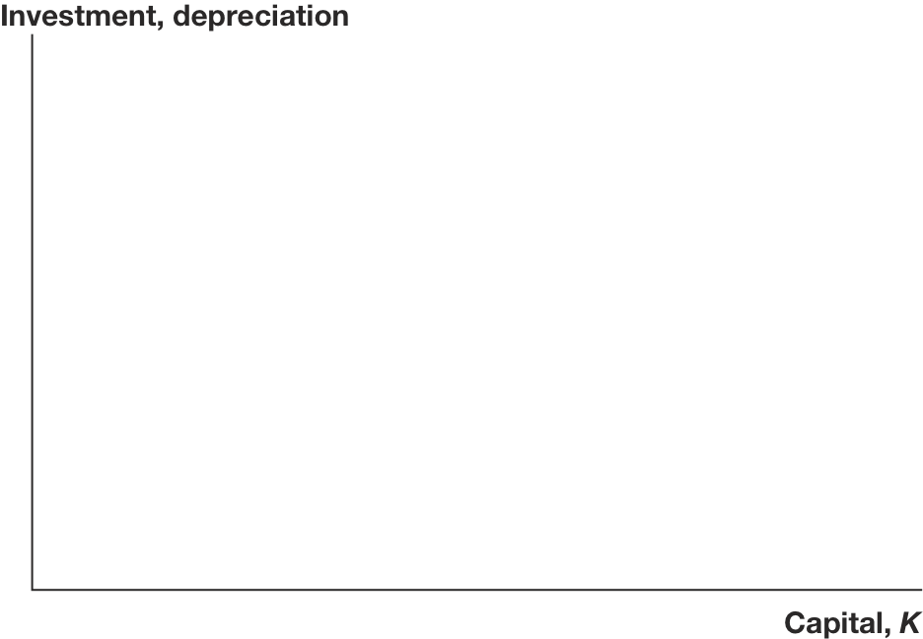
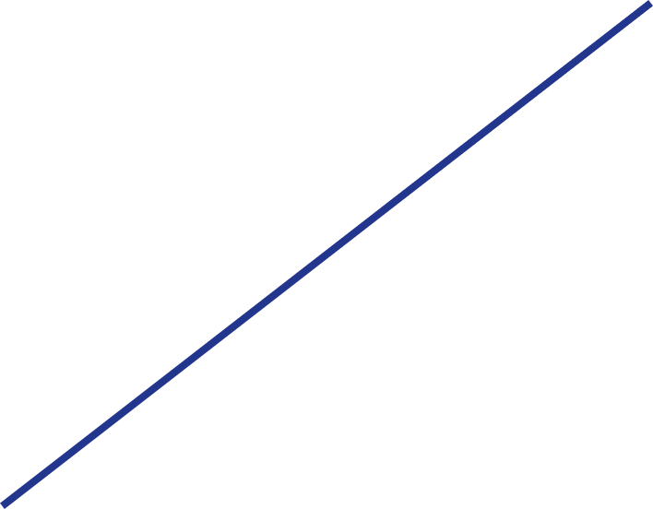
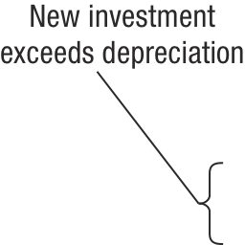
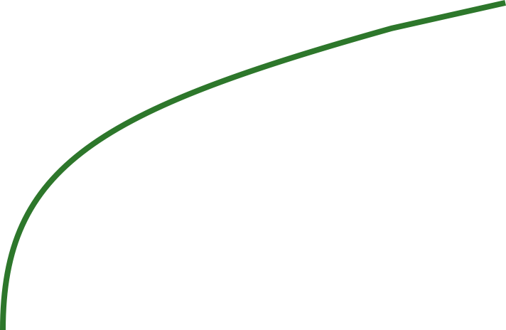
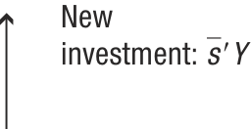
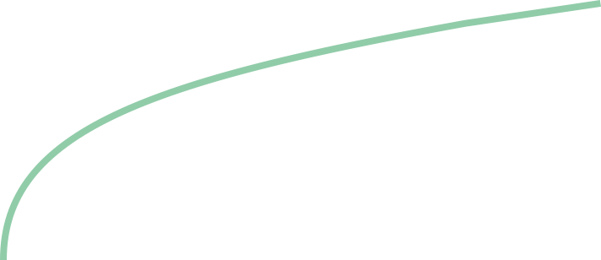
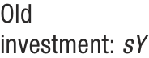
Transition dynamics – increase in saving rate
Source: Jones – Macroeconomics

Slide 34
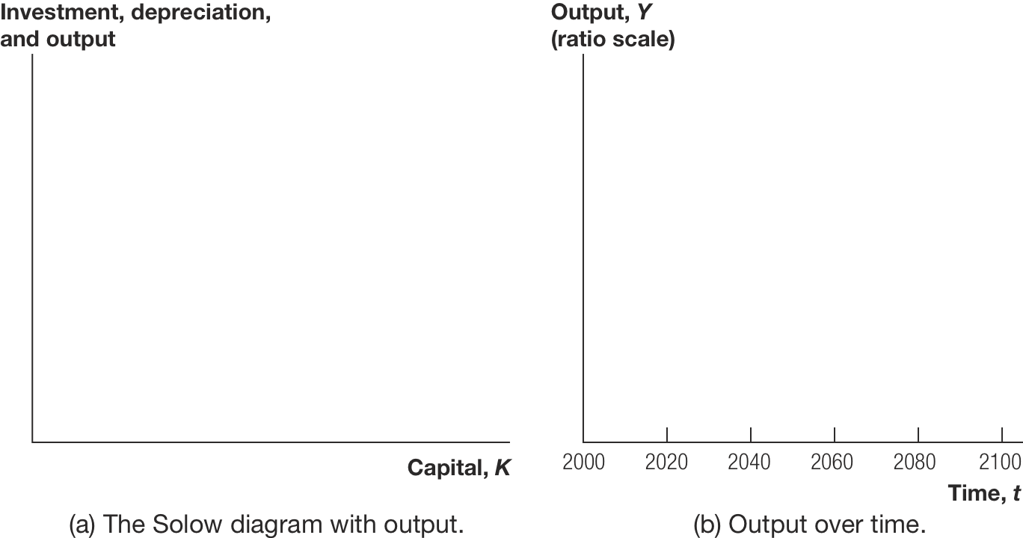
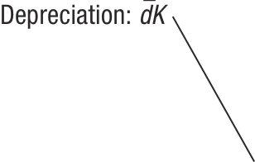

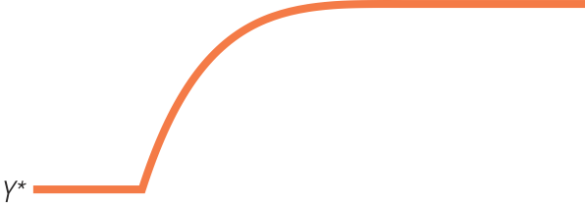
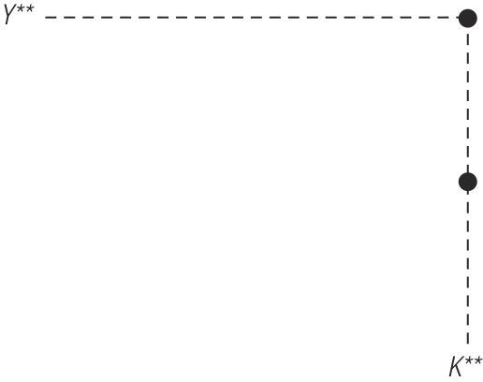

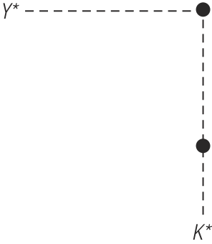
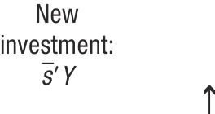
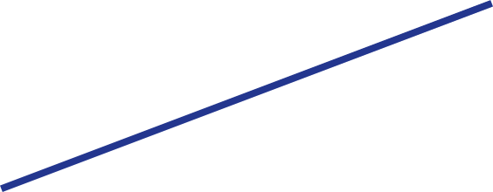

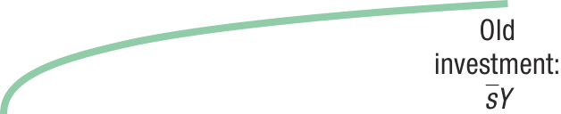
Transition dynamics – increase in saving rate
Source: Jones – Macroeconomics

Slide 35
Transition dynamics
Questions we can ask with this model:
Imagine that the economy starts in the steady state, and a natural disaster destroys 20% of the capital stock. What happens then?
Imagine that the economy starts in the steady state with a saving rate of 10%. What happens when the saving rate increases to 15%?
What happens when TFP in the economy suddenly increases by 10%? How does the answer differ from the result in the static model of production from Chapter 4?
Capital accumulation matters.

Slide 36
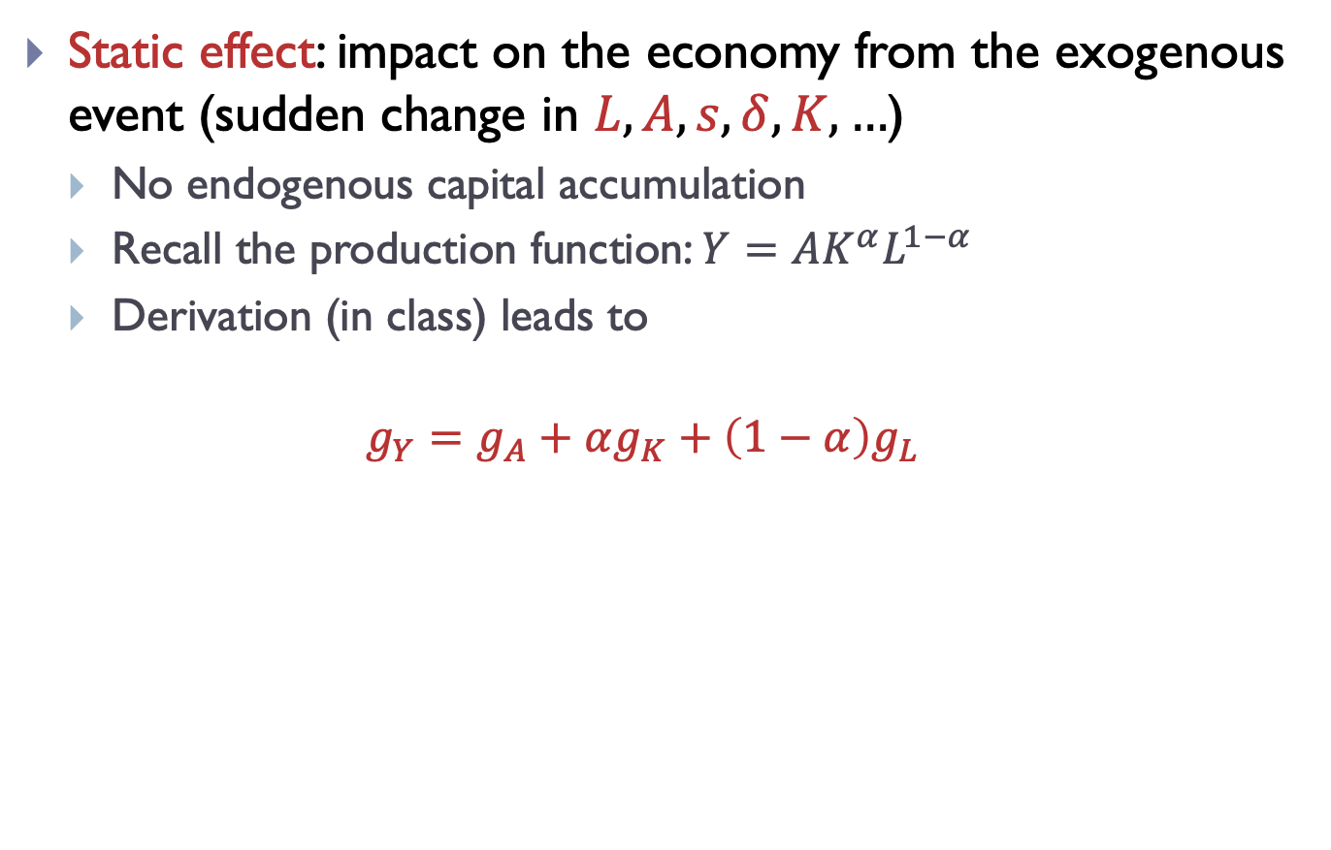
Static and dynamic effects
Static effect: impact on the economy from the exogenous event (sudden change in $L,A,s,δ,K,…$)
No endogenous capital accumulation
Recall the production function: $Y=AK^{α}L^{1−α}$
Derivation (in class) leads to
$$g_{Y}=g_{A}+αg_{K}+\left(1−α\right)g_{L}$$

Slide 37
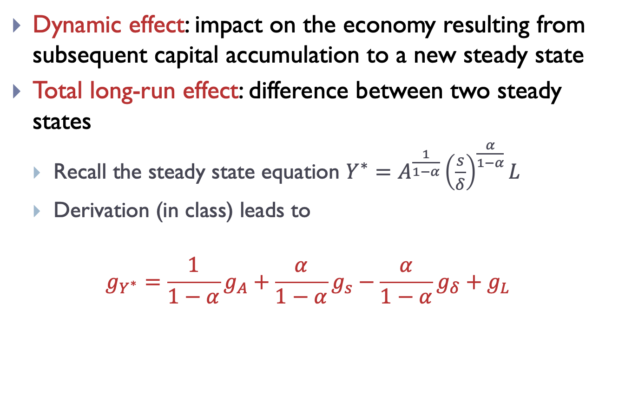
Static and dynamic effects
Dynamic effect: impact on the economy resulting from subsequent capital accumulation to a new steady state
Total long-run effect: difference between two steady states
Recall the steady state equation $Y^{∗}=A^{\frac{1}{1−α}}{\left(\frac{s}{δ}\right)}^{\frac{α}{1−α}}L$
Derivation (in class) leads to
$$g_{Y^{∗}}=\frac{1}{1−α}g_{A}+\frac{α}{1−α}g_{s}−\frac{α}{1−α}g_{δ}+g_{L}$$

Slide 38
Outline
Empirical evidence
Setting up the Solow growth model
Saving, investment, and the real interest rate
Solving the Solow growth model
Transition dynamics
Steady state analysis, comparative statics
Predictions of the model and empirical evidence
Lessons and deficiencies

Slide 39
Predictions from the model
Distance from steady state
The economy will grow the faster the farther below the steady state it is.
Prediction: Catching up.
Growth generated by capital accumulation
Growth episodes accompanied by high rates of investment.
High permanent saving rates should lead to accumulation of large amounts of capital.

Slide 40
Empirical evidence – open economies
Recall graph from the beginning of the lecture
Once countries start following plausible policies, the prediction of the Solow growth model seems to hold: catching up!
Source: Sachs, Warner (1995) Economic Reform and the Process of Globalization

Slide 41
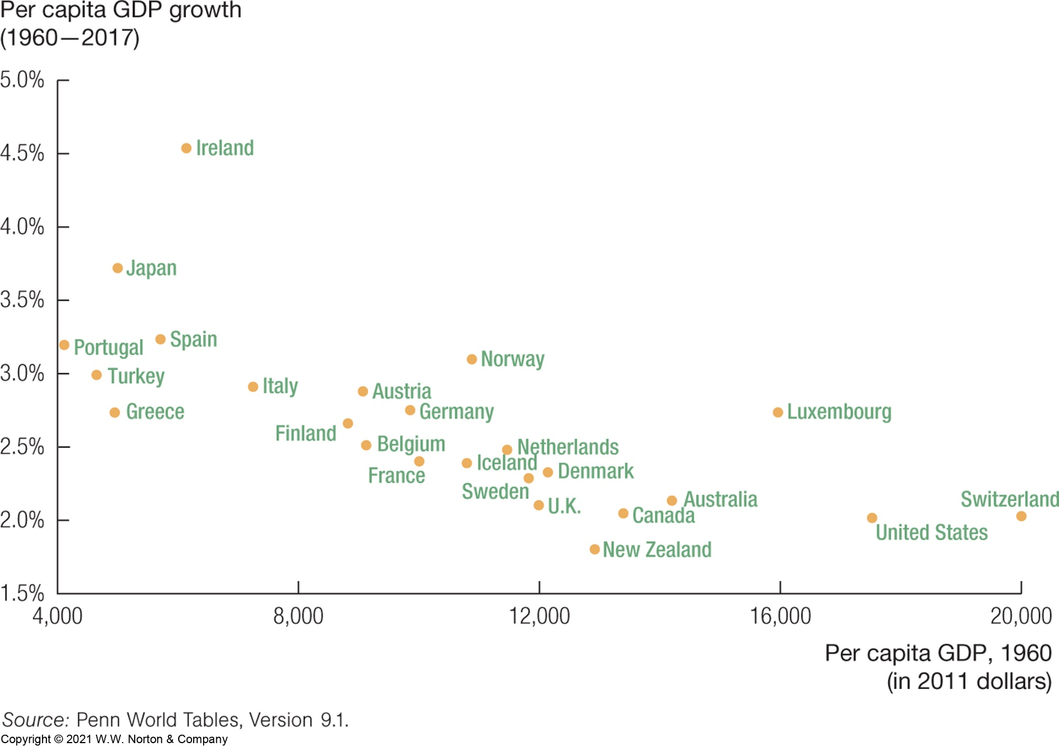
Empirical evidence – OECD countries
Poor countries in this sample indeed grow faster than rich countries.
Source: Jones – Macroeconomics

Slide 42

Empirical evidence – whole world
So why don’t these countries grow?
Source: Jones – Macroeconomics

Slide 43
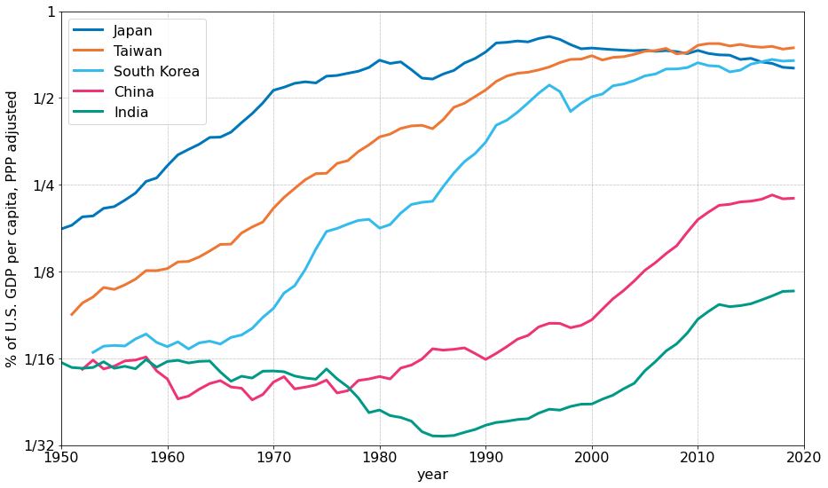
Empirical evidence – growth periods
GDP per capita as a share of U.S. GDP per capita
Source: Penn World Tables 10.0 data (https://www.rug.nl/ggdc/productivity/pwt/)

Slide 44
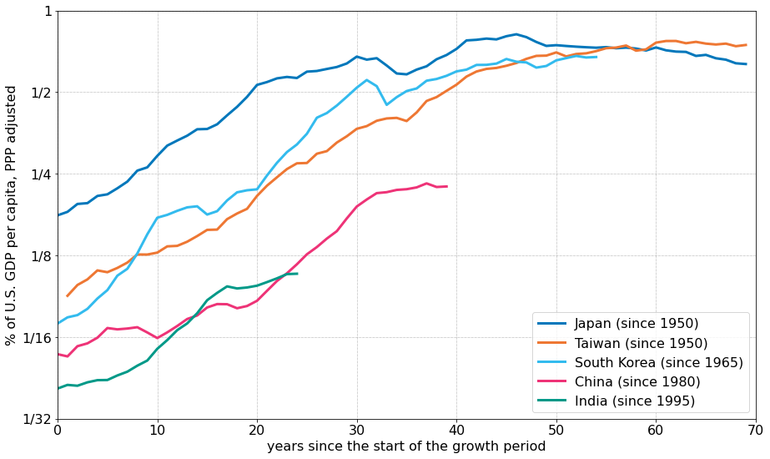
Empirical evidence – growth periods
Year 0 = start of the high-growth period
Source: Penn World Tables 10.0 data (https://www.rug.nl/ggdc/productivity/pwt/)

Slide 45
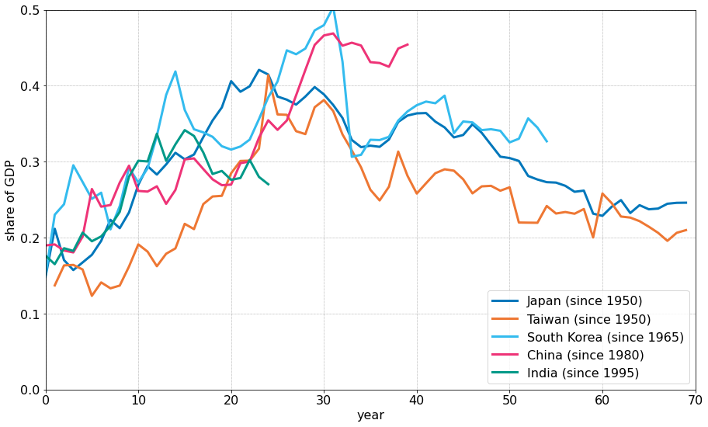
Empirical evidence – investment rates
Year 0 = start of the high-growth period
Source: Penn World Tables 10.0 data (https://www.rug.nl/ggdc/productivity/pwt/)

Slide 46
United States vs. China
United States
GDP per capita grows roughly 2% per year.
This rate is about the same for more than a century.
Interpretation: U.S. is in a “steady state”, and the steady state moves over time (this is called balanced growth path).
Investment rates are roughly constant
China (and other growth miracles)
Growth at 8-10% for more than two decades.
China started below the steady state and is converging.
Will growth in China slow down? Ultimately yes.
Think about Japan after WWII – it caught up with developed world and growth slowed to roughly the same rate as the rest of developed world.

Slide 47
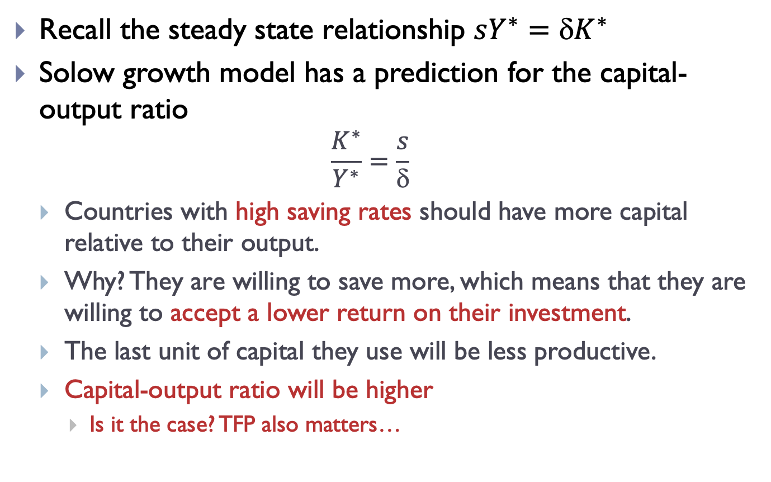
Capital-output ratio in the long-run
Recall the steady state relationship $sY^{∗}={K}^{∗}$
Solow growth model has a prediction for the capital-output ratio
$$\frac{K^{∗}}{Y^{∗}}=\frac{s}{δ}$$
Countries with high saving rates should have more capital relative to their output.
Why? They are willing to save more, which means that they are willing to accept a lower return on their investment.
The last unit of capital they use will be less productive.
Capital-output ratio will be higher
Is it the case? TFP also matters…

Slide 48
Outline
Empirical evidence
Setting up the Solow growth model
Saving, investment, and the real interest rate
Solving the Solow growth model
Transition dynamics
Steady state analysis, comparative statics
Predictions of the model and empirical evidence
Lessons and deficiencies

Slide 49
What is missing from our model?
Prices (wage, rental rate) can be reintroduced easily
The profit maximizing firm will have the same first-order conditions as in the model of production.
Household decision
What determines the saving rate?
We would need to introduce a utility-maximizing household.
Consumption/saving and work decisions are fundamental in macro.
Household trades off consumption today for consumption in the future, depending on the real rate of interest.
This complicates the model pretty significantly.
Total factor productivity still unexplained
Steady state still depends on A, which was our “measure of ignorance”. What happens when we increase A?

Slide 50
What have we learned?
In the long run, a country’s GDP per capita depends on the fraction of output invested for the future.
Transition dynamics
Poor countries should catch up fast.
Growth rates slow down as GDP per capita approaches that of developed countries.
Capital accumulation alone does not lead to long-run growth.
Other mechanisms must be at work.
Going further: Chapter 5, Jones

Slide 51
Intermediate Macroeconomics Axelle FERRIERE, Sciences Po, Spring 2025
Ch. 4
The Solow growth model

Slide 52
Summary (1/5): Model description
Variables
Capital $K_{t}$
Labor $L_{t}$
Output $Y_{t}$
Consumption $C_{t}$
Investment $I_{t}$
Parameters
Depreciation rate $$ (0.1)
Savings rate $s$ (0.2-0.5)
Size of labor force $\overline{L}$
Total factor productivity $A$
Initial amount of capital $K_{0}$
Equations
Technology:
$$Y_{t}=AK_{t}^{α}L_{t}^{1−α}$$
Resource constraint:
$$Y_{t}=C_{t}+I_{t}$$
Capital accumulation:
$$K_{t+1}=K_{t}+I_{t}−{K}_{t}$$
Saving/investment function:
$$I_{t}=sY_{t}$$
Fixed labor force:
$$L_{t}=\overline{L}$$

Slide 53
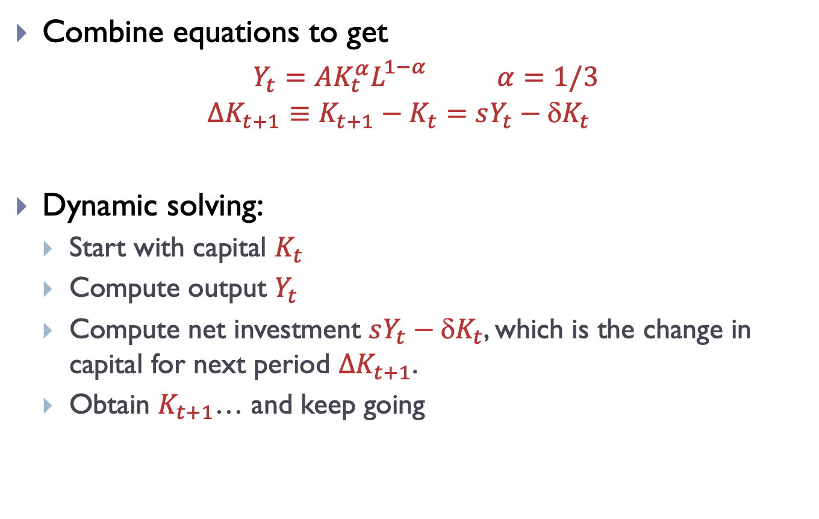
Summary (2/5): Solving the model
Combine equations to get
$Y_{t}=AK_{t}^{α}L_{}^{1−α}$ $α=1/3$
$${∆K_{t+1}≡K}_{t+1}−K_{t}=sY_{t}−{K}_{t}$$
Dynamic solving:
Start with capital $K_{t}$
Compute output $Y_{t}$
Compute net investment $sY_{t}−{K}_{t}$, which is the change in capital for next period $∆K_{t+1}$.
Obtain $K_{t+1}$… and keep going

Slide 54
Summary (3/5): Solow diagram
Steady state $sY^{∗}={K}^{∗}$
Source: Jones – Macroeconomics

Slide 55
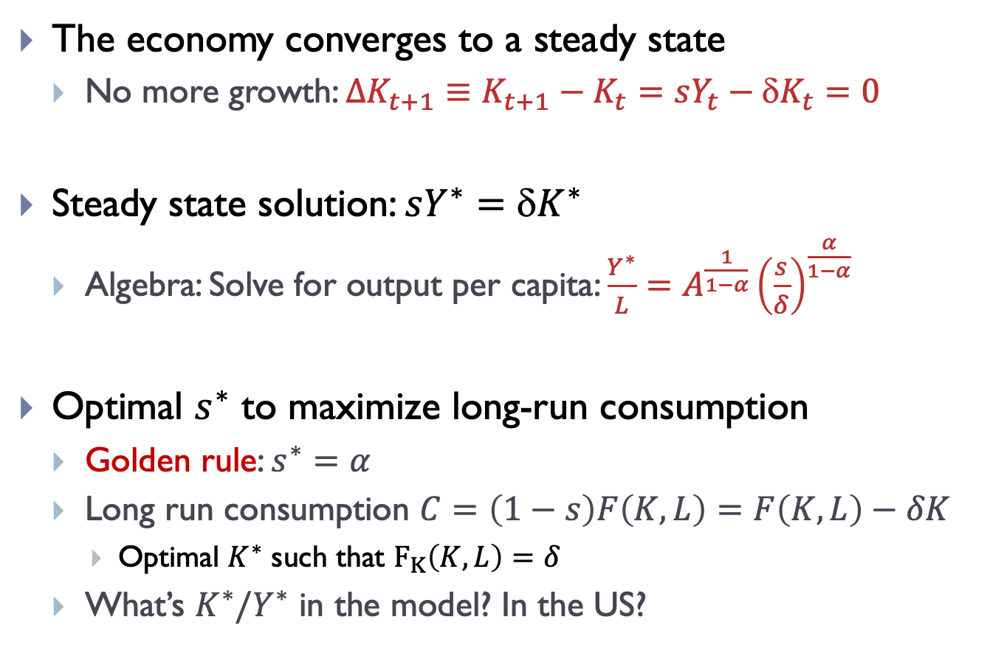
Summary (4/5): Long run solution
The economy converges to a steady state
No more growth: ${∆K_{t+1}≡K}_{t+1}−K_{t}=sY_{t}−{K}_{t}=0$
Steady state solution: $sY^{∗}={K}^{∗}$
Algebra: Solve for output per capita: $\frac{Y^{∗}}{L}=A^{\frac{1}{1−α}}{\left(\frac{s}{δ}\right)}^{\frac{α}{1−α}}$
Optimal $s^{∗}$ to maximize long-run consumption
Golden rule: $s^{∗}=α$
Long run consumption $C=\left(1−s\right)F\left(K,L\right)=F\left(K,L\right)−δK$
Optimal $K^{∗}$ such that $F_{K}\left(K,L\right)=δ$
What’s $K^{∗}/Y^{∗}$ in the model? In the US?

Slide 56

Summary (5/5): Lessons and deficiencies
Useful model to think of transitions
Model catch-up of poor countries with $K_{0}<K^{∗}$
Catch up = fast-growth episodes
Exogenous savings rate
Not a good model to think of variations of savings rate over time (Chapter 6)
Capital accumulation alone does not lead to long-run growth
Not a good model to think of long-run positive growth and balanced growth path (Chapter 5)

Slide 57
Review questions
What is the growth-generating mechanism in the Solow model?
Does the model generate sustained growth? Why or why not?
What is the real interest rate? How is it determined in the model?
Why do countries in the model differ in their growth rates?
Why do poor countries (at least the disciplined ones) growth faster than rich countries? What about the rest of the poor countries?
What is a comparative statics exercise?
What is the transition dynamics?
What happens in the model when part of the capital is destroyed? When saving rate or depreciation rate increase?
What are plausible values for the depreciation and saving rates?
What are exogenous and endogenous variables?
What are stock and flow variables?

